Slide 1
Lending Club Case Study
Analysis on Loan defaulters
Group Members:
Ruchika Janefalkar & Ruchika Agarwal

Slide 2
Business Objectives
Lending club is the largest online loan marketplace, facilitating personal loans, business loans, and financing of medical procedures. Borrowers can easily access lower interest rate loans through a fast online interface.
If one is able to identify these risky loan applicants, then such loans can be reduced thereby cutting down the amount of credit loss.
The Analysis needs to perform on the past loan applicants and find defaulters

Slide 3
Methodology
Exploratory Data Analysis
Technology used Python - Pandas ,numpy
Industry
Banking - online loan marketplace
Analyse on:
Past applicants who were defaulter.
Identify risky loan applicants

Slide 4
 | EDA
Data Cleaning & Sanity check | Data Analysis | Observations
1.Removing the null value columns. 2. Removing columns with single value. 2.Removing null values rows. 3.Make the datatype changes for analysis. 4.Check the +, ,,% signs so analysis becomes easier. 5. Categorize - numerical, categorical, extra columns for analysis purpose. Check duplicate records. Check outliners by using box plots. | Univariate Analysis – Analyse each column and plotting charts to see distribution of each column. Bivariate Analysis – Analyse relationship between two columns. Multivariate Analysis – Analyse relationship between 3 or more columns by using different graph types. | Share insight based on all earlier analysis.

Slide 5
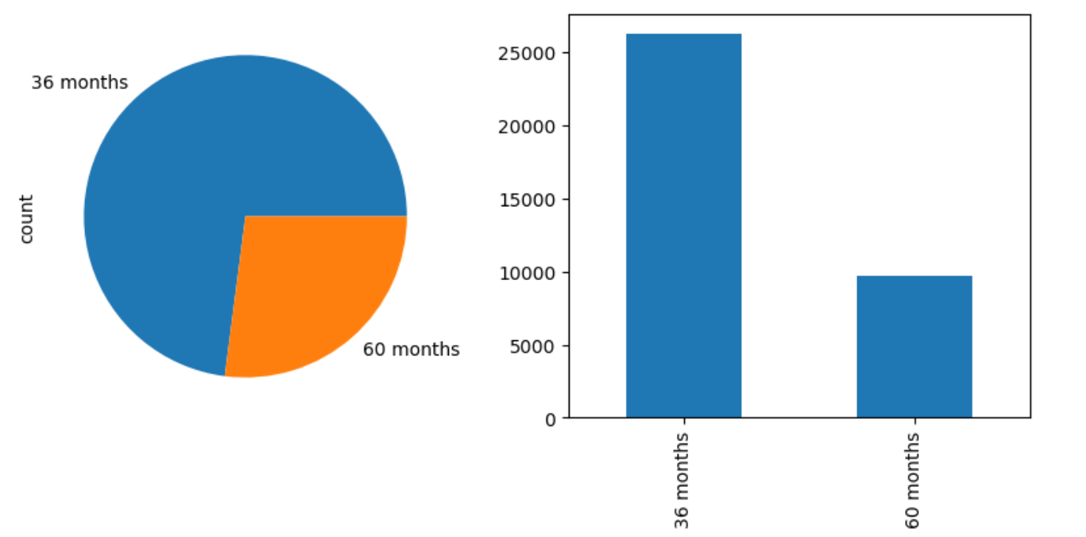
Term Column analysis
This has two terms only 36 Months and 60 Months.
This indicates that borrowers have taken 36 months tenure more than 60 months

Slide 6
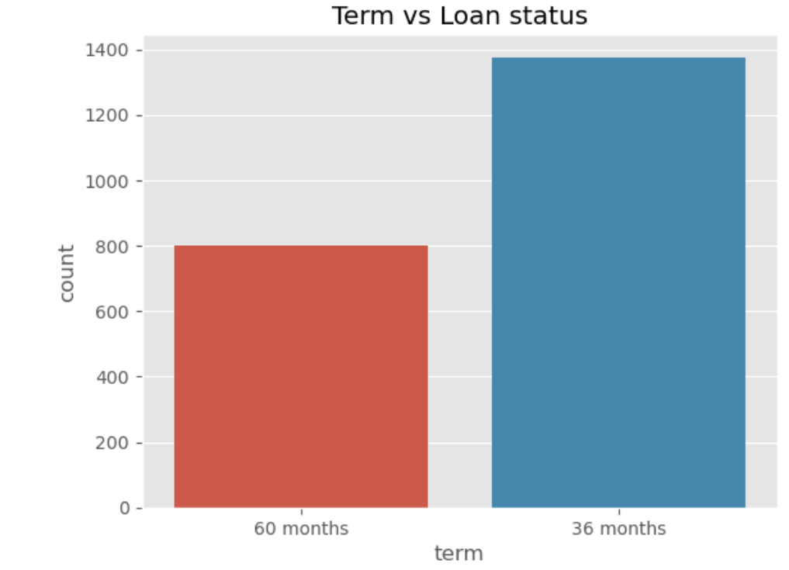
Term vs Loan status
1. 10.5% loans with 36 months defaulted.
2. 22.3% loans with 60 months defaulted.
3. The defaulters are 13.7% and fully paid is 83.3% in the data.

Slide 7
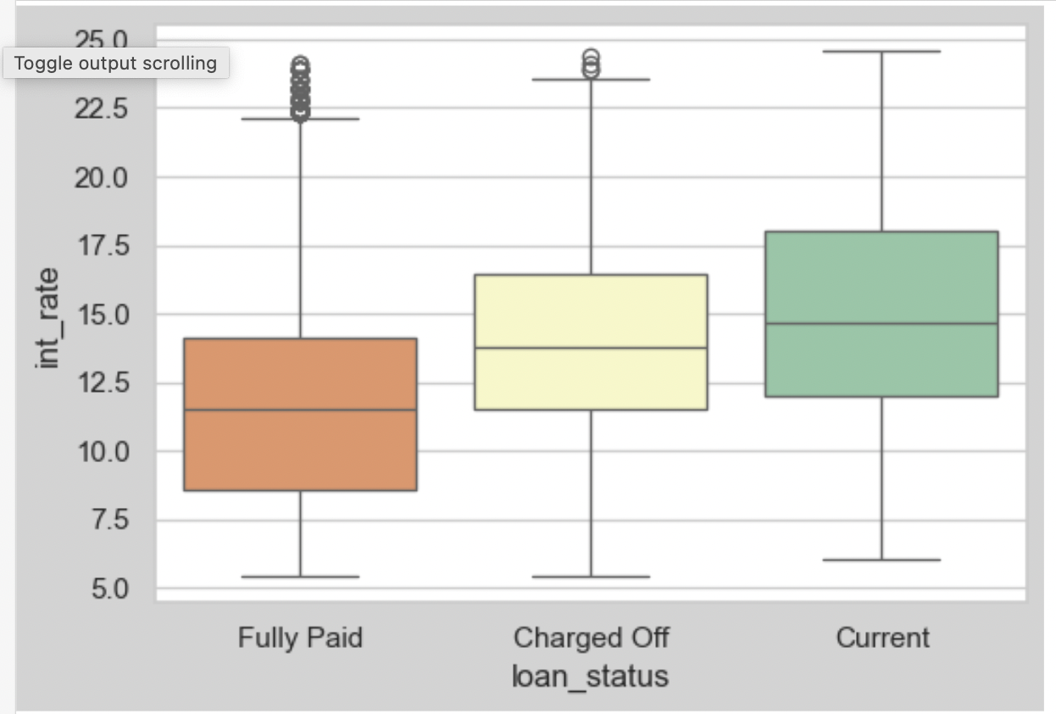
Loan status vs interest rate
This indicates that customer defaults loan when interest rate is on higher side between 11%-16%

Slide 8
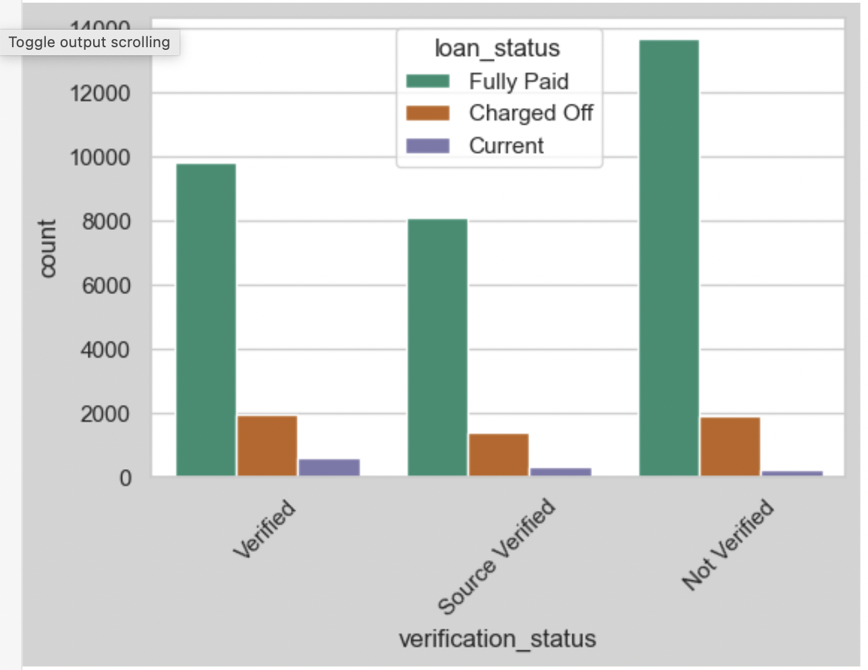
Loan Status vs Verification status
Majority of loans are ’Not Verified’. Probability of verified loans to default are more than source verified. Not verified loans are also close behind to default.
It means LC is not verifying most of the loans and the ones that are verified are not done properly and there probability to default is high.

Slide 9
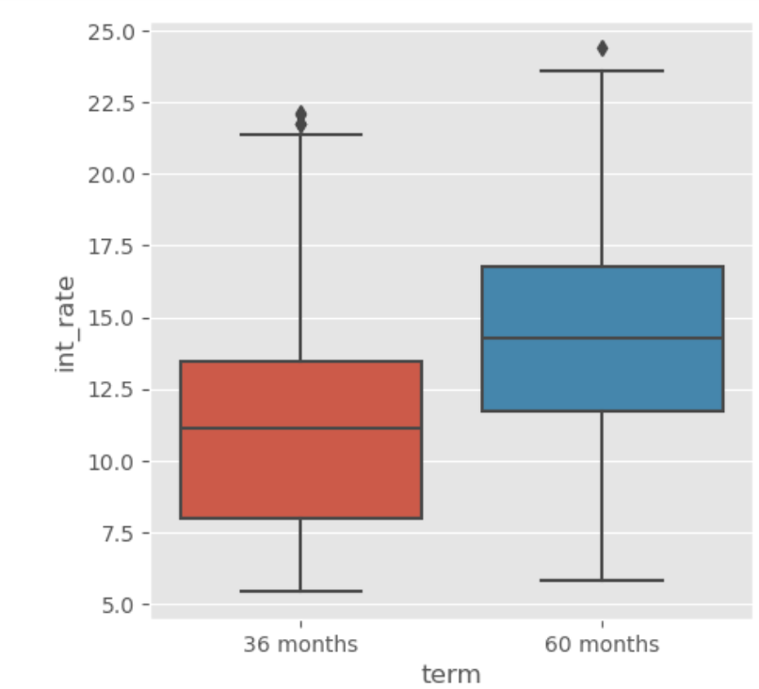
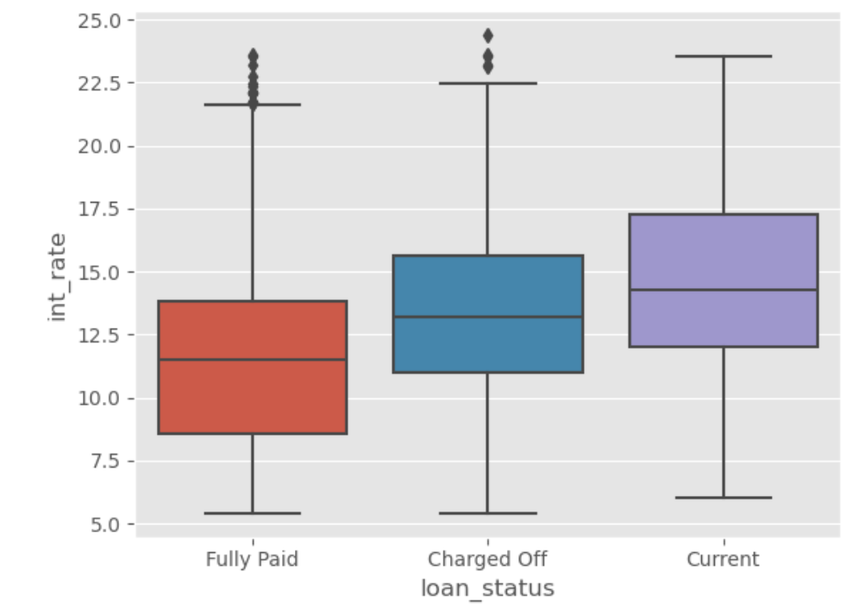
Analyze Term, Interest rate, Loan status=Charged off
The probability of increase in defaulters when interest rate is between 11.5%-16.5% and 60 months term.

Slide 10
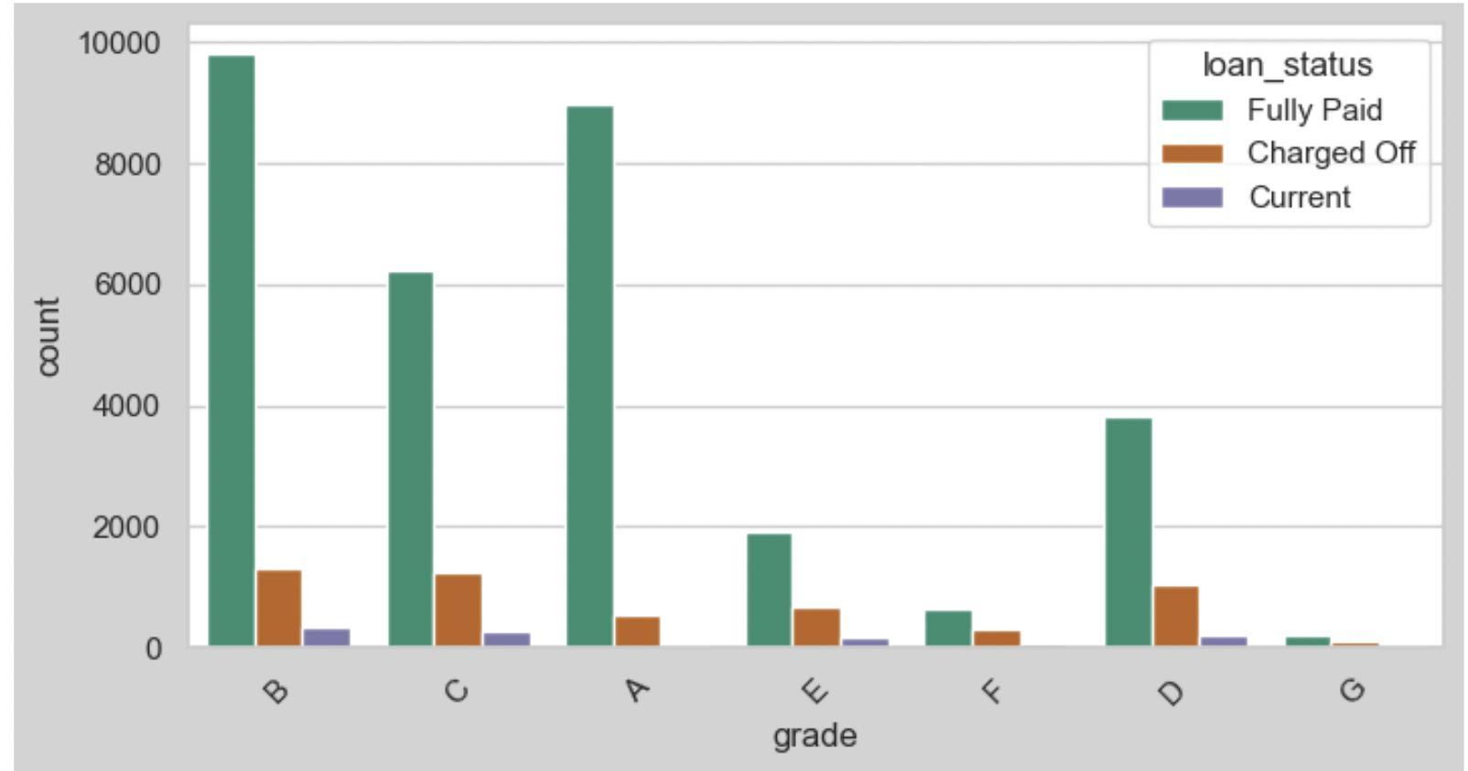
Grade vs loan status vs loan amount
There is high probability of defaulting for customer having grade G,F,E,D,C as their percentage of charged off is more as compared to the total loans of these grades.

Slide 11
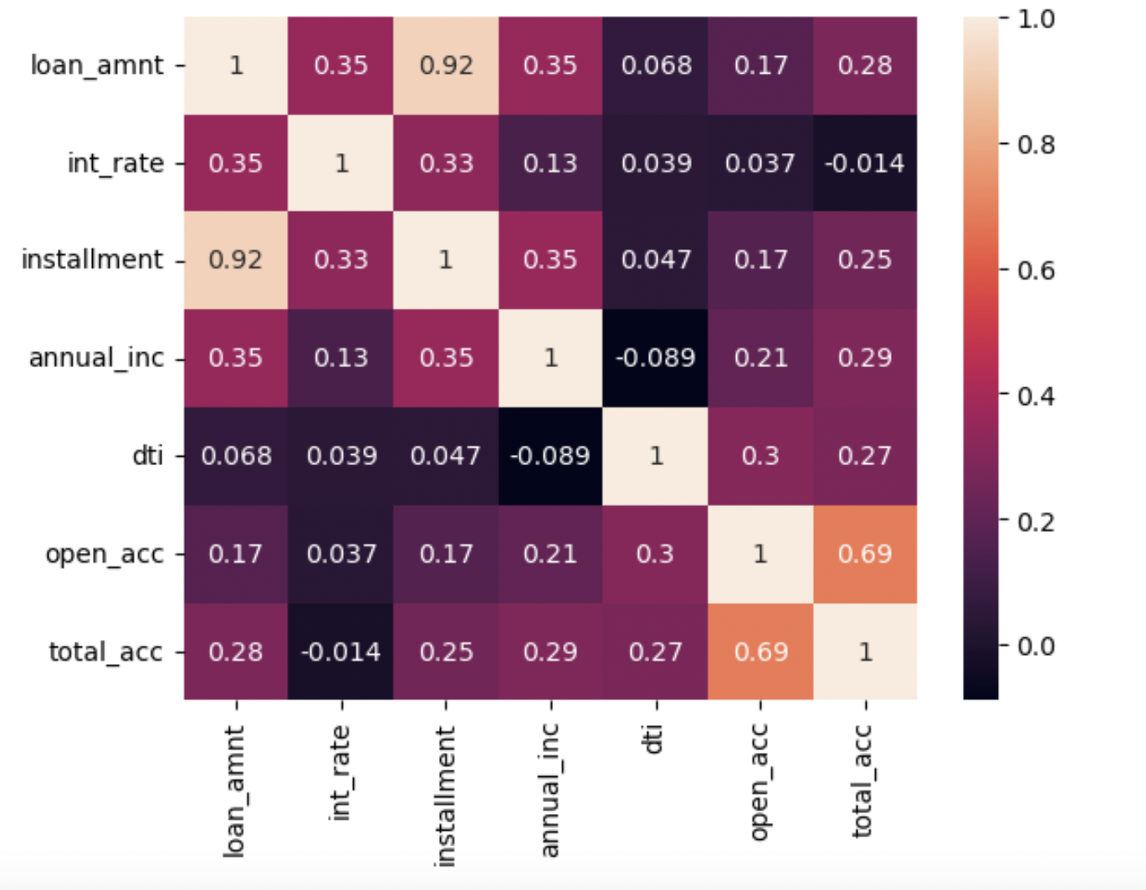
Multivariate Analysis for charged off loans

Slide 12
Inferences towards the loan to default:
Majority of loans are ’Not Verified’. Probability of verified loans to default are more than source verified. Not verified loans are also close behind to default. It means LC is not verifying most of the loans and the ones that are verified are not done properly and their probability to default is high.
On higher interest rates the average defaulters are more. Also, the loans with status - 'current' are also of higher int rates so probability of current loans to default are high.
There is no other prominent variable for a loan to default apart from interest rate. The occurrences with highest 'Charged Off's in any graph is majorly because of high amount of loan sanctioned for that value.

